Slide 1
Radians
Twitter: @Owen134866
www.mathsfreeresourcelibrary.com

Slide 2

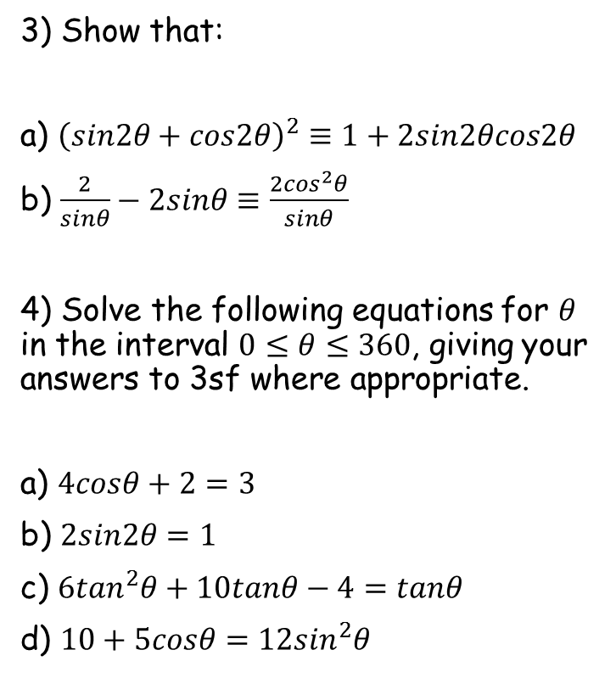

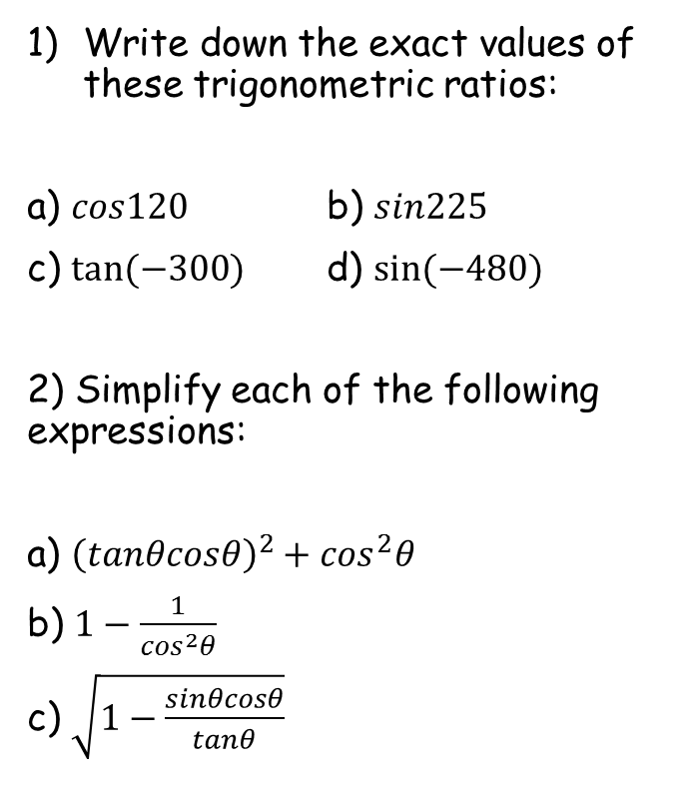





Prior Knowledge Check
Write down the exact values of these trigonometric ratios:
a) $cos120$ b) $sin225$
c) $tan⁡(−300)$ d) $sin⁡(−480)$
2) Simplify each of the following expressions:
a) ${\left(tanθcosθ\right)}^{2}+\cos^{2}θ$
b) $1−\frac{1}{\cos^{2}θ}$
c) $\sqrt{1−\frac{sinθcosθ}{tanθ}}$
3) Show that:
a) ${\left(sin2θ+cos2θ\right)}^{2}≡1+2sin2θcos2θ$
b) $\frac{2}{sinθ}−2sinθ≡\frac{2\cos^{2}θ}{sinθ}$
4) Solve the following equations for $θ$ in the interval $0≤θ≤360$, giving your answers to 3sf where appropriate.
a) $4cosθ+2=3$
b) $2sin2θ=1$
c) $6\tan^{2}θ+10tanθ−4=tanθ$
d) $10+5cosθ=12\sin^{2}θ$
$$−\frac{1}{2}$$
$$−\frac{\sqrt{2}}{2}$$
$$−\frac{\sqrt{3}}{2}$$
$$\sqrt{3}$$
$$1$$
75.5, 284
$$−\tan^{2}θ$$
15, 75, 195, 255
19.7, 118, 200, 298
$$\left|sinθ\right|$$
75.5, 132, 228, 284

Slide 3
Teachings for
Section 5A

Slide 4


Radians
$$2π radians={360}^{°}$$
$$π radians={180}^{°}$$
You can measure angles in Radians
Radians are an alternative to degrees. Some calculations involving circles are easier when Radians are used, as opposed to degrees.
‘If arc AB has length r, then angle AOB is 1 radian (1^{c} or 1 rad)’
A
r
O
1^{c}
r
r
B
Arc Length
Multiply by 2π
Arc Length
As 2πr is a complete circle, this means that 2π radians is the same as 360 degrees
÷ 2
÷ π
5A

Slide 5
Radians
$$2π radians={360}^{°}$$
$$π radians={180}^{°}$$
You can measure angles in Radians
You need to be able to convert between degrees and radians.
Convert the following angle to degrees
Multiply by ¹⁸⁰/_{π}
Radians → Degrees
Top x Top, Bottom x Bottom
Multiply by ¹⁸⁰/_{π}
Cancel out π
Work out the sum
5A

Slide 6
Radians
$$2π radians={360}^{°}$$
$$π radians={180}^{°}$$
You can measure angles in Radians
You need to be able to convert between degrees and radians.
Convert the following angle to degrees
Multiply by ¹⁸⁰/_{π}
Radians → Degrees
Top x Top, Bottom x Bottom
Multiply by ¹⁸⁰/_{π}
Cancel out π
Work out the sum
5A

Slide 7
Radians
$$2π radians={360}^{°}$$
$$π radians={180}^{°}$$
You can measure angles in Radians
You need to be able to convert between degrees and radians.
Convert the following angle to radians
Multiply by ^{π}/₁₈₀
Degrees → Radians
Only multiply the top here
Divide by ¹⁸⁰/_{π}
Simplify
Multiply by ^{π}/₁₈₀
5A

Slide 8
Radians
$$2π radians={360}^{°}$$
$$π radians={180}^{°}$$
You can measure angles in Radians
You need to be able to convert between degrees and radians.
Convert the following angle to radians
Multiply by ^{π}/₁₈₀
Degrees → Radians
Only multiply the top here
Divide by ¹⁸⁰/_{π}
Simplify
Multiply by ^{π}/₁₈₀
5A

Slide 9









Radians
$$2π radians={360}^{°}$$
$$π radians={180}^{°}$$
You can measure angles in Radians
→ You should learn to recognize some equivalences, using the relationships above…
$$π radians={180}^{°}$$
$$\frac{π}{2} radians=$$
$${90}^{°}$$
$$\frac{π}{3} radians=$$
$${60}^{°}$$
$$\frac{π}{4} radians=$$
$${45}^{°}$$
$$\frac{π}{6} radians=$$
$${30}^{°}$$
5A

Slide 10
Radians
$$2π radians={360}^{°}$$
$$π radians={180}^{°}$$
You can measure angles in Radians
When you have angles in degrees, you can calculate sine/cos/tan of them
You can also do this in radians, but you must set your calculator to radians first (a common mistake is that students forget to do this, but actually do the question correctly!)
You only need to change the mode if sine/cos/tan is involved. Regular calculations are not affected
5A

Slide 11
Radians
$$2π radians={360}^{°}$$
$$π radians={180}^{°}$$
y
y = sinθ
You can measure angles in Radians
→ You also need to be able to sketch and use graphs where radians are the units…
1
-π 2
0
π 2
θ
-2π
-3π 2
-π
-90º
π
3π 2
-360º
-270º
-180º
90º
180º
270º
360º
2π
-1
y
y = cosθ
1
0
θ
-π
-π 2
π 2
π
3π 2
-2π
-3π 2
-90º
-360º
-270º
-180º
90º
180º
270º
360º
2π
-1
y = tanθ
1
0
θ
-π
-π 2
π 2
π
3π 2
-2π
-3π 2
-90º
-360º
-270º
-180º
90º
180º
270º
360º
2π
-1
5A

Slide 12

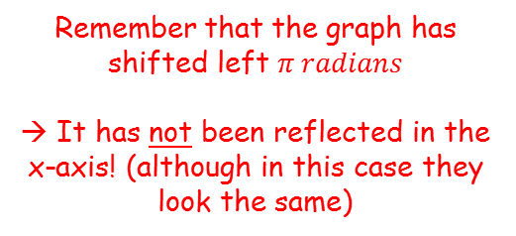








Radians
$$2π radians={360}^{°}$$
$$π radians={180}^{°}$$
You can measure angles in Radians
→ Sketch the graph of $y=cos\left(x+π\right)$ for $0≤x≤2π$.
Horizontal shift, $π$ units left
y
1
$$y=cosx$$
0
$$π$$
x
$$\frac{π}{2}$$
$$\frac{3π}{2}$$
$$2π$$
-1
y
Remember that the graph has shifted left $π radians$
→ It has not been reflected in the x-axis! (although in this case they look the same)
1
0
$$π$$
x
$$\frac{π}{2}$$
$$\frac{3π}{2}$$
$$2π$$
-1
$$y=cos⁡(x+π)$$
5A

Slide 13
Teachings for
Section 5B

Slide 14



























Radians
$$2π radians={360}^{°}$$
$$π radians={180}^{°}$$
You should also try to learn some of the exact values of trig ratios (similar to when using degrees). These can help in proofs.
Radians
Degrees
$$0$$
$$\frac{π}{6}$$
$$\frac{π}{4}$$
$$\frac{π}{3}$$
$$\frac{π}{2}$$
$$0$$
$$30$$
$$45$$
$$60$$
$$90$$
$$sin$$
$$0$$
$$\frac{1}{2}$$
$$\frac{\sqrt{2}}{2}$$
$$\frac{\sqrt{3}}{2}$$
$$1$$
$$cos$$
$$1$$
$$\frac{\sqrt{3}}{2}$$
$$\frac{\sqrt{2}}{2}$$
$$\frac{1}{2}$$
$$0$$
$$tan$$
$$0$$
$$\frac{\sqrt{3}}{3}$$
$$1$$
$$\sqrt{3}$$
$$−$$
5B

Slide 15

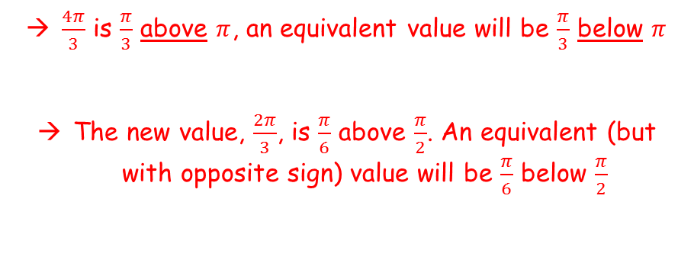









Radians
$$2π radians={360}^{°}$$
$$π radians={180}^{°}$$
y
$$\frac{π}{3}$$
You should also try to learn some of the exact values of trig ratios (similar to when using degrees). These can help in proofs.
Find the exact value of:
$$cos\frac{4π}{3}$$
$$\frac{2π}{3}$$
$$\frac{4π}{3}$$
$$y=cosx$$
1
$$\frac{π}{6}$$
0
x
$$\frac{π}{2}$$
$$π$$
$$\frac{3π}{2}$$
$$2π$$
$$\frac{π}{6}$$
-1
$$\frac{π}{3}$$
$$\frac{π}{3}$$
You can use a CAST diagram or the symmetry of the cosine graph to find an equivalent value
$\frac{4π}{3}$ is $\frac{π}{3}$ above $π$, an equivalent value will be $\frac{π}{3}$ below $π$
The new value, $\frac{2π}{3}$, is $\frac{π}{6}$ above $\frac{π}{2}$. An equivalent (but with opposite sign) value will be $\frac{π}{6}$ below $\frac{π}{2}$
$$cos\frac{4π}{3}$$
$$= cos\frac{2π}{3}$$
$$=−cos\frac{π}{3}$$
$$=−\frac{1}{2}$$
5B

Slide 16













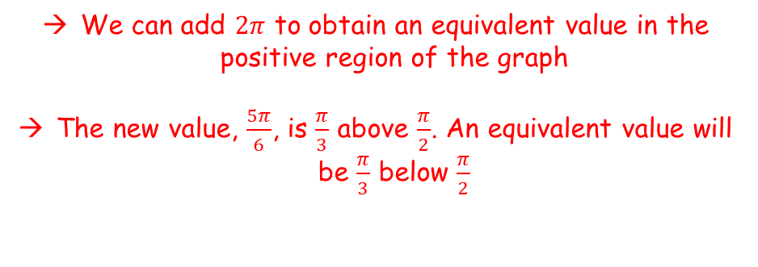





Radians
$$2π radians={360}^{°}$$
$$π radians={180}^{°}$$
We can add $2π$ to obtain an equivalent value in the positive region of the graph
The new value, $\frac{5π}{6}$, is $\frac{π}{3}$ above $\frac{π}{2}$. An equivalent value will be $\frac{π}{3}$ below $\frac{π}{2}$
You should also try to learn some of the exact values of trig ratios (similar to when using degrees). These can help in proofs.
Find the exact value of:
$$sin\left(−\frac{7π}{6}\right)$$
$$sin\left(−\frac{7π}{6}\right)$$
$$=sin\left(\frac{5π}{6}\right)$$
$$=sin\left(\frac{π}{6}\right)$$
$$=\frac{1}{2}$$
$$−\frac{7π}{6}$$
$$\frac{π}{6}$$
$$\frac{5π}{6}$$
$$y$$
$$1$$
$$\frac{π}{3}$$
$$\frac{π}{3}$$
$$x$$
$$−2π$$
$$−\frac{3π}{2}$$
$$−π$$
$$−\frac{π}{2}$$
$$\frac{π}{2}$$
$$π$$
$$\frac{3π}{2}$$
$$2π$$
$$y=sinx$$
$$−1$$
5B

Slide 17
Teachings for
Section 5C

Slide 18

Radians
$$2π radians={360}^{°}$$
$$l=rθ$$
$$π radians={180}^{°}$$
Finding the length of an arc is easier when you use radians
r
θ
l
=
r
=
Multiply by 2π
=
Multiply by r
=
(The angle must be in radians!)
5C

Slide 19
Radians
$$2π radians={360}^{°}$$
$$l=rθ$$
$$π radians={180}^{°}$$
Finding the length of an arc is easier when you use radians
Find the length of the arc of a circle of radius 5.2cm. The arc subtends an angle of 0.8^{c} at the centre of the circle.
=
=
=
5C

Slide 20
Radians
$$2π radians={360}^{°}$$
$$l=rθ$$
$$π radians={180}^{°}$$
Finding the length of an arc is easier when you use radians
Arc AB of a circle, with centre O and radius r, subtends an angle of θ radians at O. The Perimeter of sector AOB is P cm. Express r in terms of P and θ.
Length AB = rθ
Factorise
Divide by (θ + 2)
A
r
O
θ
rθ
r
B
5C

Slide 21
Radians
$$2π radians={360}^{°}$$
$$l=rθ$$
$$π radians={180}^{°}$$
Calculator in Radians
Finding the length of an arc is easier when you use radians
The border of a garden pond consists of a straight edge AB of length 2.4m, and a curved part C, as shown in the diagram below. The curved part is an arc of a circle, centre O and radius 2m. Find the length of C.
O
(H)
2m
x
A
1.2m
B
Inverse sine
(O)
Double for angle AOB
C
Angle θ = 2π – 1.287
Angle θ = 4.996 rad
θ
4.996^{c}
2m
2m
O
1.287^{c}
A
2.4m
B
(We need to work out angle θ)
5C

Slide 22
Teachings for
Section 5D

Slide 23

Radians
$$2π radians={360}^{°}$$
$$l=rθ$$
$$π radians={180}^{°}$$
$$A=\frac{1}{2}r^{2}θ$$
The Area of a Sector and Segment can be worked out using Radians
=
A
=
Multiply by π
O
θ
X
=
Multiply by r²
B
=
=
This is the formula’s usual form
5D

Slide 24
Radians
$$2π radians={360}^{°}$$
$$l=rθ$$
$$π radians={180}^{°}$$
$$A=\frac{1}{2}r^{2}θ$$
The Area of a Sector and Segment can be worked out using Radians
In the diagram, the area of the minor sector AOB is 28.9cm². Given that angle AOB is 0.8 rad, calculate the value of r.
Put the numbers in
½ x 0.8 = 0.4
A
Divide by 0.4
r cm
O
0.8^{c}
B
Square root
5D

Slide 25
Radians
$$2π radians={360}^{°}$$
$$l=rθ$$
$$π radians={180}^{°}$$
$$A=\frac{1}{2}r^{2}θ$$
The Area of a Sector and Segment can be worked out using Radians
A plot of land is in the shape of a sector of a circle of radius 55m. The length of fencing that is needed to enclose the land is 176m. Calculate the area of the plot of land.
The length of the arc must be 66m (adds up to 176 total)
Put the numbers in
Divide by 55
A
55m
Put the numbers in
66m
θ
O
1.2^{c}
55m
B
(We need to work out the angle first)
5D

Slide 26

Radians
$$2π radians={360}^{°}$$
$$Segment=\frac{1}{2}r^{2}(θ−sinθ)$$
$$l=rθ$$
$$π radians={180}^{°}$$
$$A=\frac{1}{2}r^{2}θ$$
The Area of a Sector and Segment can be worked out using Radians
You can also work out the area of a segment using radians.
Area of a Segment
Area of Sector AOB – Area of Triangle AOB
Area of Sector AOB
Area of Triangle AOB
a = b = r
C = θ
O
r
θ
r
Area of the Segment
A
B
Factorise
5D

Slide 27
Radians
$$2π radians={360}^{°}$$
$$Segment=\frac{1}{2}r^{2}(θ−sinθ)$$
$$l=rθ$$
$$π radians={180}^{°}$$
$$A=\frac{1}{2}r^{2}θ$$
The Area of a Sector and Segment can be worked out using Radians
Calculate the Area of the segment shown in the diagram below.
Substitute the numbers in
Work the parts out
Only round the final answer
O
π 3
2.5cm
5D

Slide 28
Radians
$$2π radians={360}^{°}$$
$$Segment=\frac{1}{2}r^{2}(θ−sinθ)$$
$$l=rθ$$
$$π radians={180}^{°}$$
$$A=\frac{1}{2}r^{2}θ$$
The Area of a Sector and Segment can be worked out using Radians
In the diagram AB is the diameter of a circle of radius r cm, and angle BOC = θ radians. Given that the Area of triangle AOC is 3 times that of the shaded segment, show that 3θ – 4sinθ = 0.
Area of the shaded segment
Area of triangle AOC
a = b = r Angle = π-θ
Remember, sin x = sin (180 – x)
C
θ
AOC = 3 x shaded segment
A
0
B
Cancel out ¹/₂r²
Multiply out the brackets
Subtract sinθ
5D

Slide 29
Teachings for
Section 5E

Slide 30











Radians
$$Tanθ≡\frac{Sinθ}{Cosθ}$$
$${Sin}^{2}θ+{Cos}^{2}θ≡1$$
You have seen how to solve trigonometric equation in degrees last year. You can also do the same when they are given in radians.
Solve the equation:
$4cosθ=2,$ $0≤θ≤2π$
$$4cosθ=2$$
Divide by 4
$$cosθ=0.5$$
Use inverse cos (ensure your calculator is in radians)
$$θ=\frac{π}{3}$$
You can subtract the answer from $2π$ to find an alternative in the range given
$$θ=\frac{5π}{3}$$
y
1
$$y=cosx$$
$$0.5$$
0
$$π$$
x
$$\frac{π}{3}$$
$$\frac{π}{2}$$
$$\frac{3π}{2}$$
$$\frac{5π}{3}$$
$$2π$$
-1
5E

Slide 31








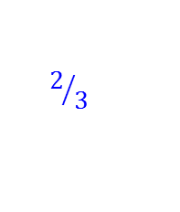








Radians
$$Tanθ≡\frac{Sinθ}{Cosθ}$$
$${Sin}^{2}θ+{Cos}^{2}θ≡1$$
You have seen how to solve trigonometric equation in degrees last year. You can also do the same when they are given in radians.
Solve the equation:
$17cosθ+3\sin^{2}θ=13,$ $0≤θ≤2π$
$$17cosθ+3\sin^{2}θ=13$$
Replace $\sin^{2}θ$ using the relationship above
$$17cosθ+3\left(1−\cos^{2}θ\right)=13$$
Expand bracket
$$17cosθ+3−3\cos^{2}θ=13$$
Rearrange and set equal to 0
$$3\cos^{2}θ−17cosθ+10=0$$
Factorise (or use the quadratic formula)
$$5$$
$$\left(3cosθ−2\right)\left(cosθ−5\right)=0$$
y
Solve for $cosθ$
$$y=cosx$$
$$cosθ=\frac{2}{3}$$
or
$$cosθ=5$$
1
$$2/3$$
Inverse cos
No solutions!
0
$$π$$
x
$$\frac{3π}{2}$$
$$2π$$
$$0.84$$
$$\frac{π}{2}$$
$$\text{5.44}$$
-1
$$θ=0.84 rad$$
Subtract from $2π$
$$θ=5.44 rad$$
5E

Slide 32

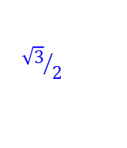





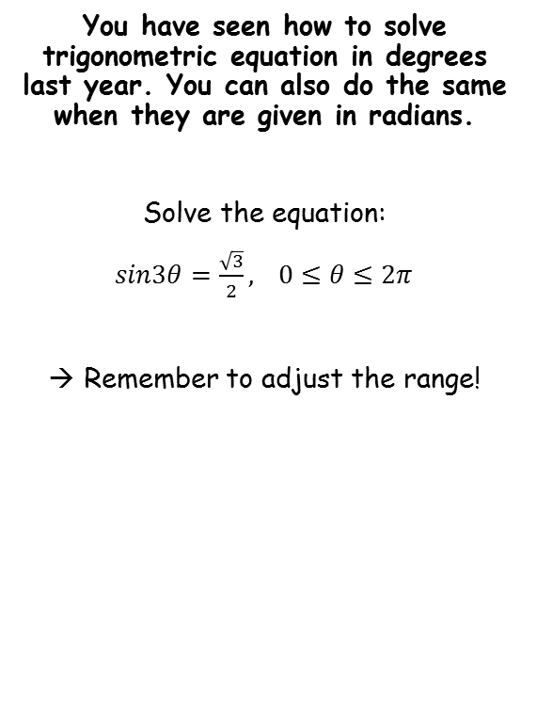

















Radians
$$Tanθ≡\frac{Sinθ}{Cosθ}$$
$${Sin}^{2}θ+{Cos}^{2}θ≡1$$
$$sin3θ=\frac{\sqrt{3}}{2}$$
You have seen how to solve trigonometric equation in degrees last year. You can also do the same when they are given in radians.
Solve the equation:
$sin3θ=\frac{\sqrt{3}}{2},$ $0≤θ≤2π$
Remember to adjust the range!
Inverse sine
$$3θ=\frac{π}{3}$$
At this point you should find all values within the range you calculated
→ Leave the dividing by 3 until last!
$$3θ=\frac{π}{3}$$
$$, \frac{2π}{3}$$
$$, \frac{7π}{3}$$
$$, \frac{8π}{3}$$
$$, \frac{13π}{3}$$
$$, \frac{14π}{3}$$
Divide by 3
$$θ=\frac{π}{9}$$
$$, \frac{2π}{9}$$
$$, \frac{7π}{9}$$
$$, \frac{8π}{9}$$
$$, \frac{13π}{9}$$
$$, \frac{14π}{9}$$
$$y$$
$$0≤θ≤2π$$
$$1$$
Multiply by 3
$${\sqrt{3}}/2$$
$$0≤3θ≤6π$$
$$x$$
$$\frac{π}{3}$$
$$\frac{π}{2}$$
$$\frac{2π}{3}$$
$$π$$
$$\frac{3π}{2}$$
$$2π$$
$$y=sinx$$
$$−1$$
Remember you can add on multiples of $2π$ to these to find more values…
5E

Slide 33
Teachings for
Section 5F

Slide 34
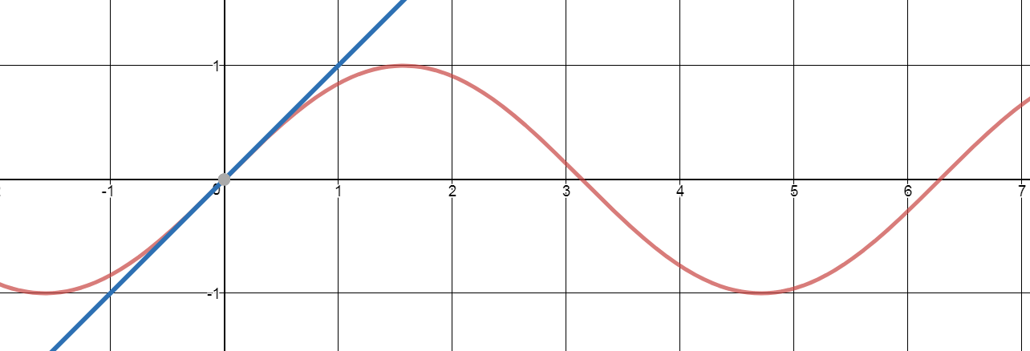
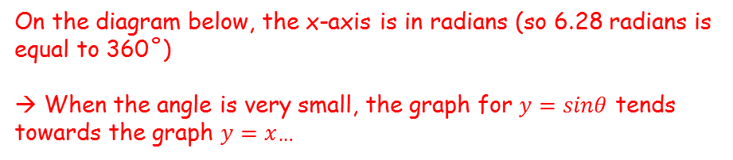








Radians
When $θ$ is small and measured in radians
$$sinθ≈θ$$
On the diagram below, the x-axis is in radians (so 6.28 radians is equal to 360˚)
→ When the angle is very small, the graph for $y=sinθ$ tends towards the graph $y=x$…
You need to understand and be able to use the small angle approximations for $sinθ$, $cosθ$ and $tanθ$
$$y$$
$$y=θ$$
$$y=sinθ$$
$$θ$$
→ Therefore, we can say that when $θ$ is small and measured in radians, $sinθ≈θ$
5F

Slide 35
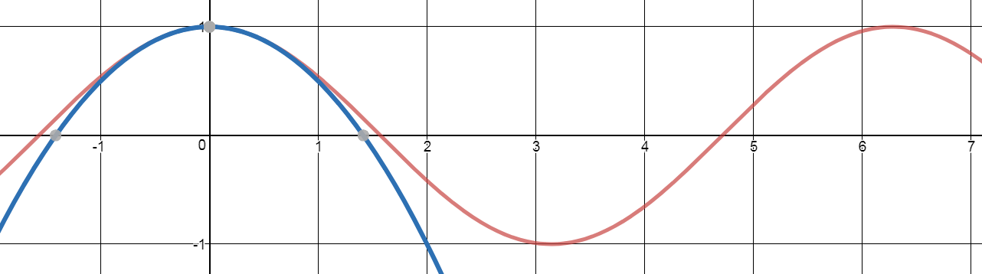
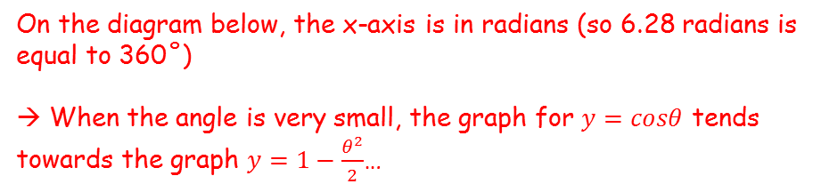






Radians
When $θ$ is small and measured in radians
$$sinθ≈θ$$
$$cosθ≈1−\frac{θ^{2}}{2}$$
On the diagram below, the x-axis is in radians (so 6.28 radians is equal to 360˚)
→ When the angle is very small, the graph for $y=cosθ$ tends towards the graph $y=1−\frac{θ^{2}}{2}$…
You need to understand and be able to use the small angle approximations for $sinθ$, $cosθ$ and $tanθ$
$$y$$
$$y=cosθ$$
$$θ$$
$$y=1−\frac{θ^{2}}{2}$$
→ Therefore, we can say that when $θ$ is small and measured in radians, $cosθ≈1−\frac{θ^{2}}{2}$
5F

Slide 36
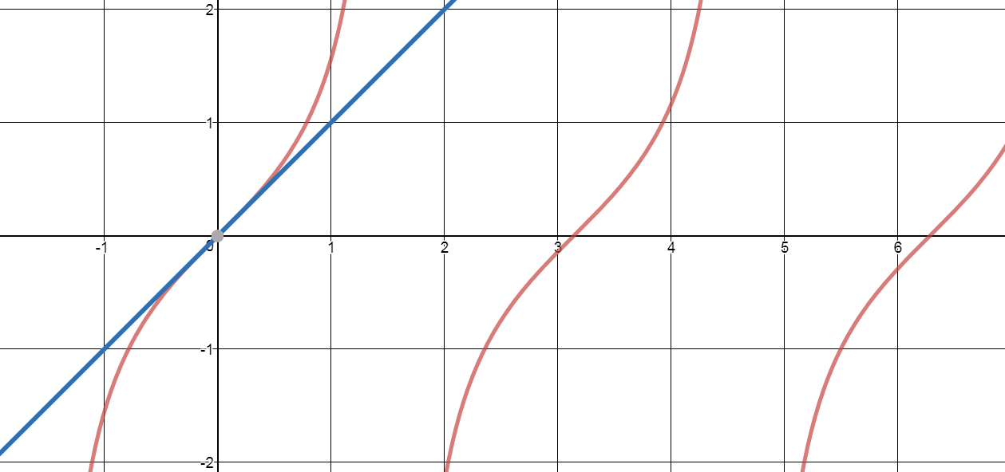
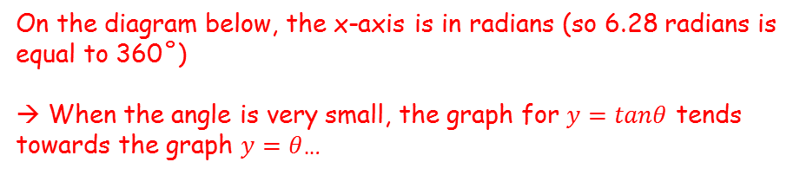





Radians
When $θ$ is small and measured in radians
$$sinθ≈θ$$
$$cosθ≈1−\frac{θ^{2}}{2}$$
$$tanθ≈θ$$
On the diagram below, the x-axis is in radians (so 6.28 radians is equal to 360˚)
→ When the angle is very small, the graph for $y=tanθ$ tends towards the graph $y=θ$…
You need to understand and be able to use the small angle approximations for $sinθ$, $cosθ$ and $tanθ$
$$y$$
$$y=θ$$
$$y=tanθ$$
$$θ$$
→ Therefore, we can say that when $θ$ is small and measured in radians, $tanθ≈θ$
5F

Slide 37




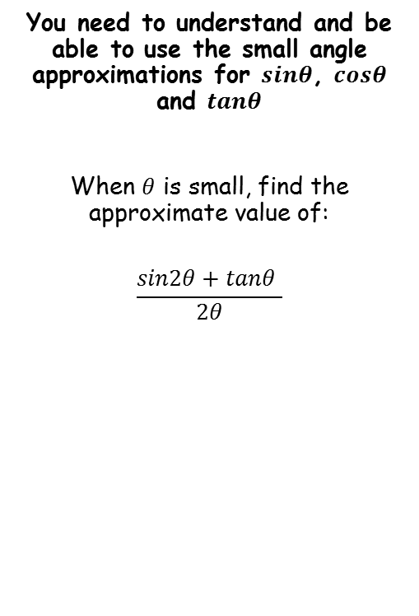





Radians
When $θ$ is small and measured in radians
$$sinθ≈θ$$
$$cosθ≈1−\frac{θ^{2}}{2}$$
$$tanθ≈θ$$
You need to understand and be able to use the small angle approximations for $sinθ$, $cosθ$ and $tanθ$
When $θ$ is small, find the approximate value of:
$$\frac{sin2θ+tanθ }{2θ}$$
$$\frac{sin2θ+tanθ }{2θ}$$
Use the rules we saw for when $θ$ is small and measured in radians
$$=\frac{2θ+θ }{2θ}$$
Simplify
$$=\frac{3θ}{2θ}$$
Simplify again
$$=\frac{3}{2}$$
We can check this by substituting a small value for $θ$ into the original expression
$$\frac{sin2θ+tanθ }{2θ}$$
Let $θ=0.005$
$$=\frac{sin2(0.005)+tan\text{(0.005)} }{2(0.005)}$$
Calculate
We can see that the approximation we have is accurate!
$$=1.4999875$$
5F

Slide 38
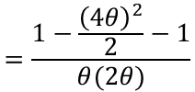



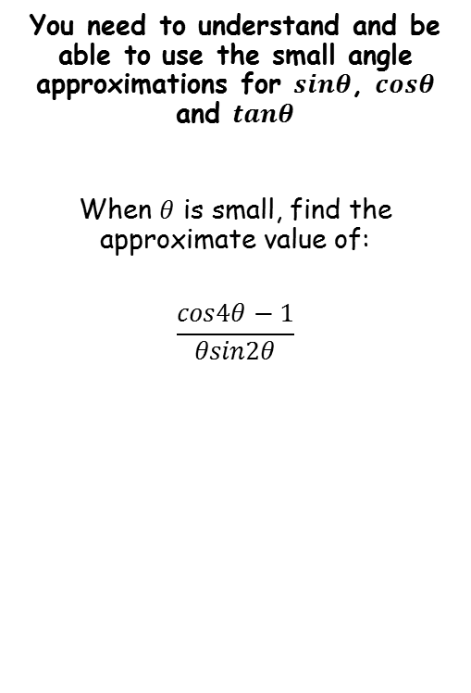






Radians
When $θ$ is small and measured in radians
$$sinθ≈θ$$
$$cosθ≈1−\frac{θ^{2}}{2}$$
$$tanθ≈θ$$
$$\frac{cos4θ−1}{θsin2θ}$$
You need to understand and be able to use the small angle approximations for $sinθ$, $cosθ$ and $tanθ$
When $θ$ is small, find the approximate value of:
$$\frac{cos4θ−1}{θsin2θ}$$
Replace expressions using the approximations above…
$$=\frac{1−\frac{{\left(4θ\right)}^{2}}{2}−1}{θ(2θ)}$$
Simplify numerator and denominator
$$=\frac{−\frac{{16θ}^{2}}{2}}{{2θ}^{2}}$$
Simplify numerator again
$$=\frac{{−8θ}^{2}}{{2θ}^{2}}$$
Divide both by $2θ^{2}$
$$=−4$$
We can check this by substituting a small value for $θ$ into the original expression
$$\frac{cos4θ−1}{θsin2θ}$$
Let $θ=0.005$
$$=\frac{cos4(0.005)−1}{(0.005)sin2(0.005)}$$
Calculate
$$=−3.999933…$$
5F

Slide 39







Radians
When $θ$ is small and measured in radians
$$sinθ≈θ$$
$$cosθ≈1−\frac{θ^{2}}{2}$$
$$tanθ≈θ$$
You need to understand and be able to use the small angle approximations for $sinθ$, $cosθ$ and $tanθ$
a) Show that, when $θ$ is small:
$$sin5θ+tan2θ−cos2θ≈{2θ}^{2}+7θ−1$$
$$sin5θ+tan2θ−cos2θ$$
Use the rules we saw for when $θ$ is small and measured in radians
$$=5θ+2θ−\left(1−\frac{{(2θ)}^{2}}{2}\right)$$
‘Expand’ bracket
$$=5θ+2θ−1+\frac{{4θ}^{2}}{2}$$
Simplify terms
$$=7θ−1+{2θ}^{2}$$
Rewrite
$$={2θ}^{2}+7θ−1$$
5F

Slide 40



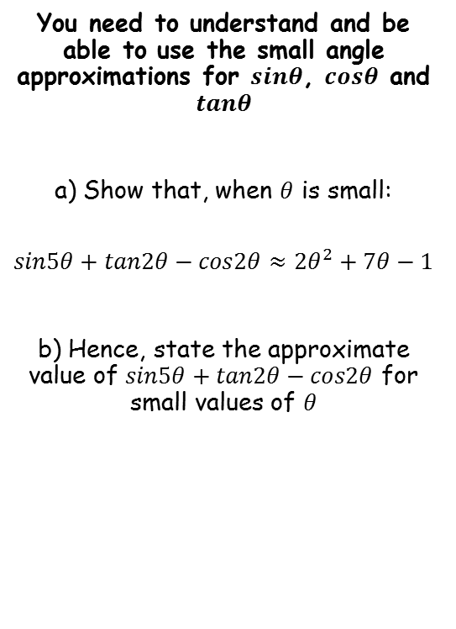



Radians
When $θ$ is small and measured in radians
$$sinθ≈θ$$
$$cosθ≈1−\frac{θ^{2}}{2}$$
$$tanθ≈θ$$
You need to understand and be able to use the small angle approximations for $sinθ$, $cosθ$ and $tanθ$
a) Show that, when $θ$ is small:
$$sin5θ+tan2θ−cos2θ≈{2θ}^{2}+7θ−1$$
b) Hence, state the approximate value of $sin5θ+tan2θ−cos2θ$ for small values of $θ$
$${2θ}^{2}+7θ−1$$
If $θ$ is small and in radians, any terms in $θ$ and $θ^{2}$ will also be small (ie – negligible)
$$=−1$$
We can check this by substituting a small value for $θ$ into the original expression
$$sin5θ+tan2θ−cos2θ$$
Let $θ=0.005$
$$=sin5(0.005)+tan2(0.005)−cos2(0.005)$$
Calculate
$$=−0.9649…$$
5F

Slide 41
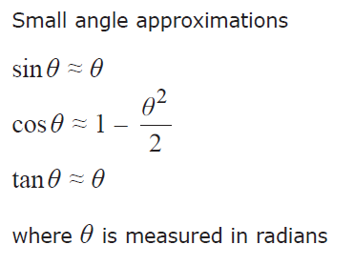

Radians
You need to understand and be able to use the small angle approximations for $sinθ$, $cosθ$ and $tanθ$
You are given these relationships in the formula booklet…
5F

